Slide 1
E – Project…
Quick
Calligraphy

Slide 2
Faculty Name : Miss Anum Hussain
Co-Ordinator : Miss Madiha Fatima.
Batch Code : 2306G1.
Student Name :
M . Arsalan. Nauman Rashid.
Abdul Moiz. Abid Aslam.

Slide 3

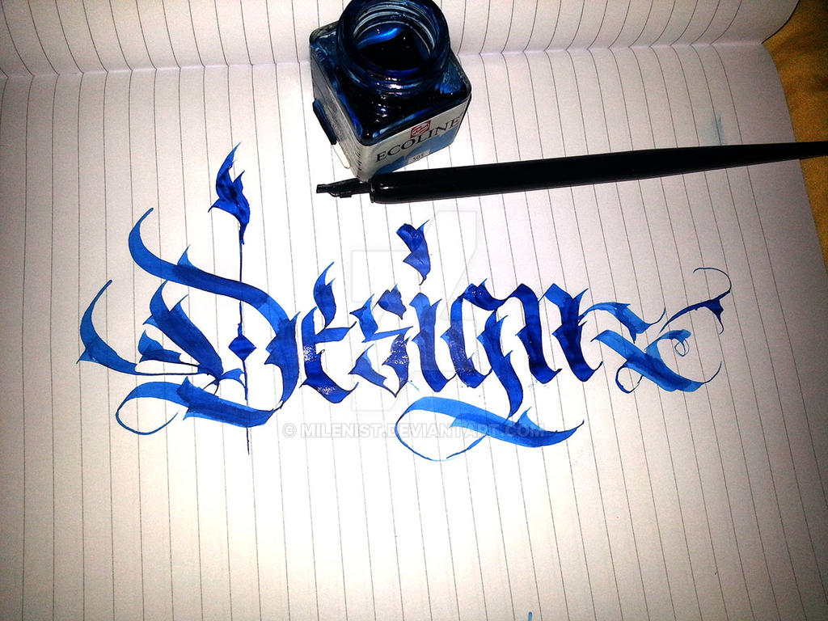
Quick Calligraphy
BY : M. Arsalan , Nauman Rashid , Abdul Moiz , Abid Aslam.

Slide 4
E-Project Description
Calligraphy is the art of forming beautiful symbols by hand and arranging them well. It’s a set of skills and techniques for positioning and inscribing words so they show integrity, harmony, some sort of ancestry, rhythm and creative fire.

Slide 5
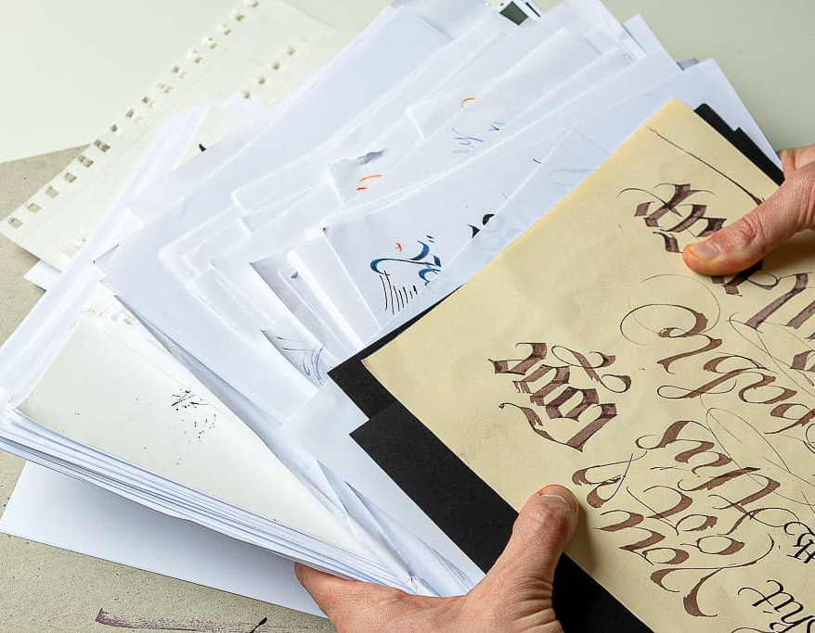
Site map look
Home
Our Gallery
Our Product
Services
About Us
Contact Us

Slide 6
This Show How Our Site-Map Look.
Home
Contact Us
Our Product
Our Gallery
About Us
Services
Easy For Kids
Complex For Elder’s

Slide 7
User Able To Do This Task
User end
Home
Our Gallery
Product
Detail
Contact us
About Us
Our Product

Slide 8
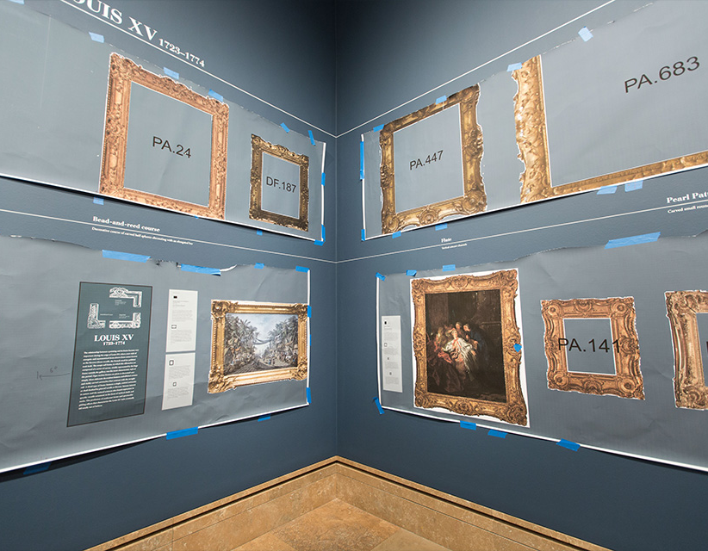
Our Gallery
Art of beautiful, stylized, or elegant handwriting or lettering with pen or brush and ink. It involves the correct formation of characters, the ordering of the various parts, and the harmony of proportions. In the Islamic and Chinese cultures, calligraphy is as highly revered as painting.

Slide 9

Our Product’s
Our products are basically Picture Canvas provided on all kind of materials, whether you then on a Poster for Decoration or Presentation Or you want them in Frames we offer wide variety of Picture Frames like Laminated Wood, Glass, Steal.

Slide 10

Contact Us
This contact-us page should provide visitors with clear instructions on how to get in touch with our business.
This includes a contact form, additional contact information (e.g., phone number, email address), and a brief introduction or message that highlights your commitment to customer service.

Slide 11
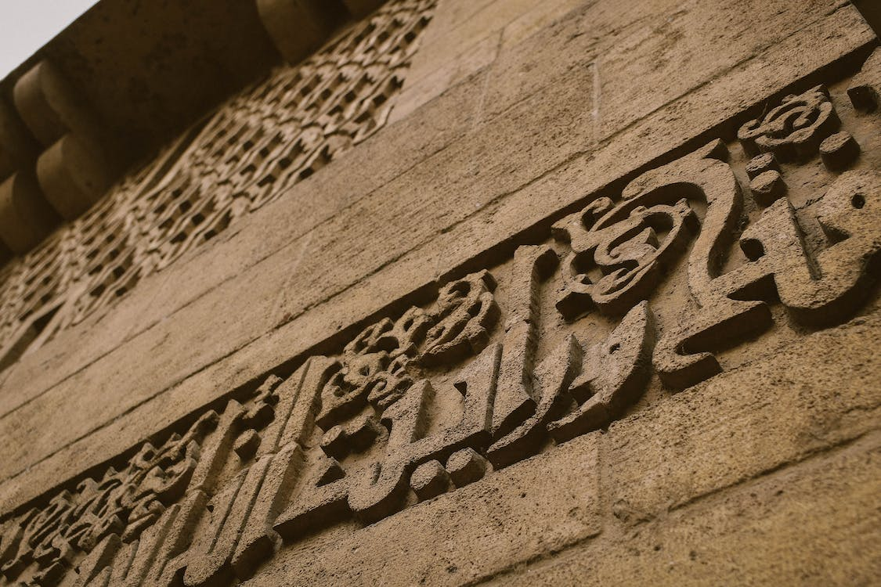
Introduction
Calligraphy is the art of forming beautiful symbols by hand and arranging them well. It’s a set of skills and techniques for positioning and inscribing words so they show integrity, harmony, some sort of ancestry, rhythm and creative fire.
Here we are aiming to design a website “Quick Calligraphy” which will provide an easy way to learn calligraphy and provide the basic other details about the art.

Slide 12
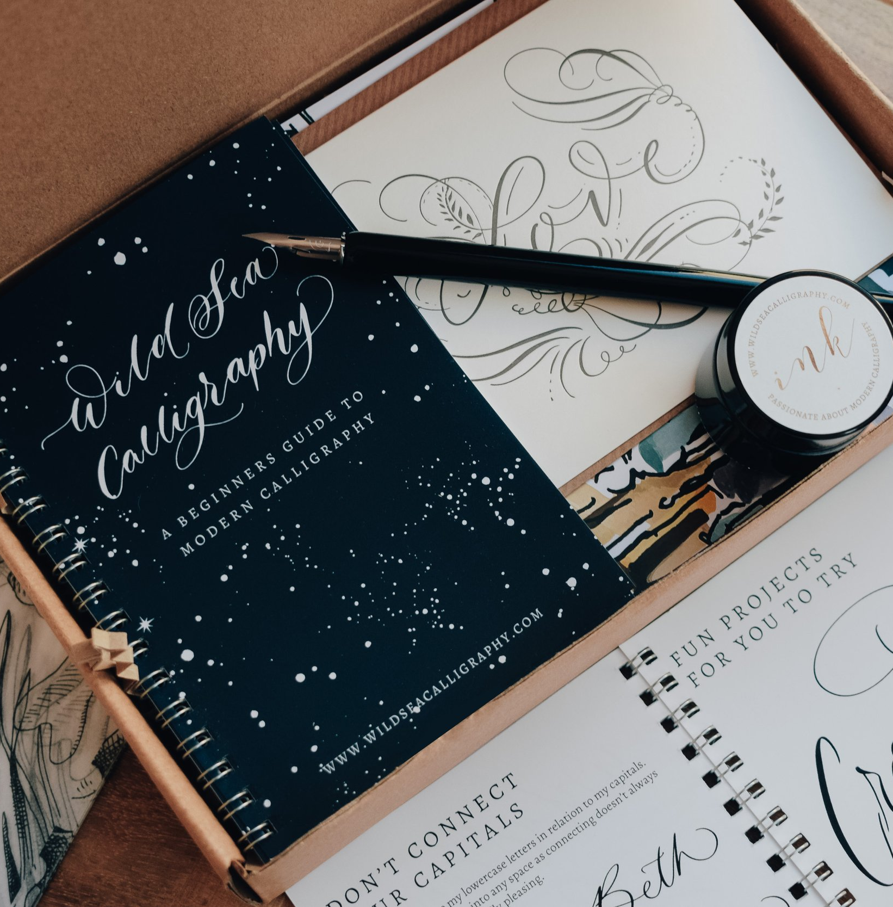
Future Enhancement
Calligraphy never ends for centuries and it make our house beautiful. It is way to express our imagination through art and designs. It is in various field like fine art and typeface designing, sign making and manuscript design etc.

Slide 13
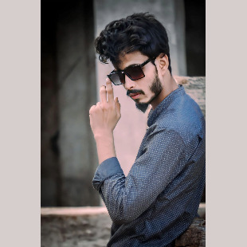
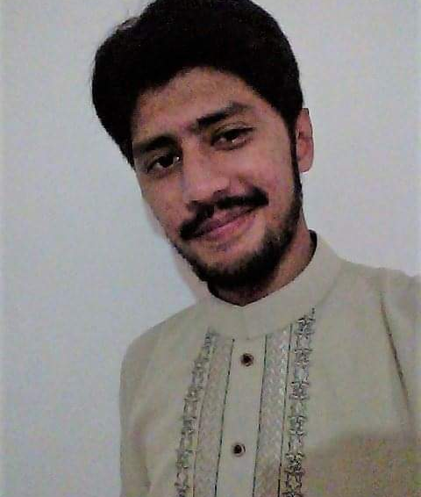

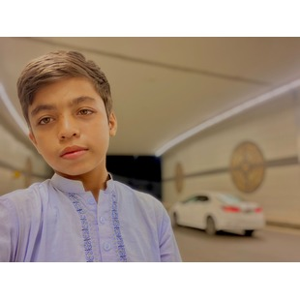
Meet our team
Muhammad Arsalan
Nauman Rashid
Abdul Moiz
Abid Aslam​
Student
Student
Student
Student

Slide 14

Thank you
Our Team.
Xyz @ gmail.com
Phone : 123 456 789..

Slide 15

Any Question..?
Any Question You Ask About This Presentation..

